Slide 1
Political Bias in BERT
CSC 630 Master’s Independent Study
Rahil Sarvaiya

Slide 2

Introduction & Idea
Hypothesis - A pretrained BERT model fine-tuned on a dataset consisting of news articles would inherit the political bias existing in the articles.
Transformers can learn universal language representations.
Can sometimes be biased.
They learn useful patterns in the text
Pick up harmful and nuanced knowledge.

Slide 3


News articles have inherent bias in them.
Different publications tend to favor particular political parties.
The aim is to train a BERT model on this bias dataset, and check if the predictions made by this model would be biased towards the Left-leaning party (Democrats) or the Right-leaning political party (Republicans).

Slide 4
What exactly is the political bias?
Example: Republicans decided to [MASK] their mask during the press conference. (Here [MASK] is the predicted word which would be “remove”) Democrats decided to [MASK] their mask during the press conference. (Here [MASK] is the predicted word which would be “wear”)
California [MASK] Republicans for medical supply shortages.
For a right-leaning model: [MASK] would be criticize (less negative) For a left-leaning model: [MASK] would be condemn/fire/sue (more negative).
Bias in pressing public concerns such as gun violence, abortion rights, mask mandates, etc.

Slide 5
Training dataset & Validation dataset
Training Dataset
Consists of ~144k News articles from 15 mainstream news outlets.
Downsampled the dataset and trained on 10,000 articles.
The main attributes of the dataset are:
'Publication': Media outlet that published the news article.
'Text': The text content of the news article.
Left-leaning (~65k): ABC News, CBS News, CNN, MSNBC, Washington Post, Al Jazeera English, MSNBC, Google News, Buzzfeed
Right-leaning (~44k): Fox News, Breitbart News, The Washington Times
Validation dataset
A set of ~50-60 political sentences that cover pressing issues such as covid norms, mask mandates, abortion rights, gun violence, etc.
These sentences had a target and an attribute word.
For the P_{target}, the target word was [MASK] and for P_{prior}, the attribute was [MASK].

Slide 6
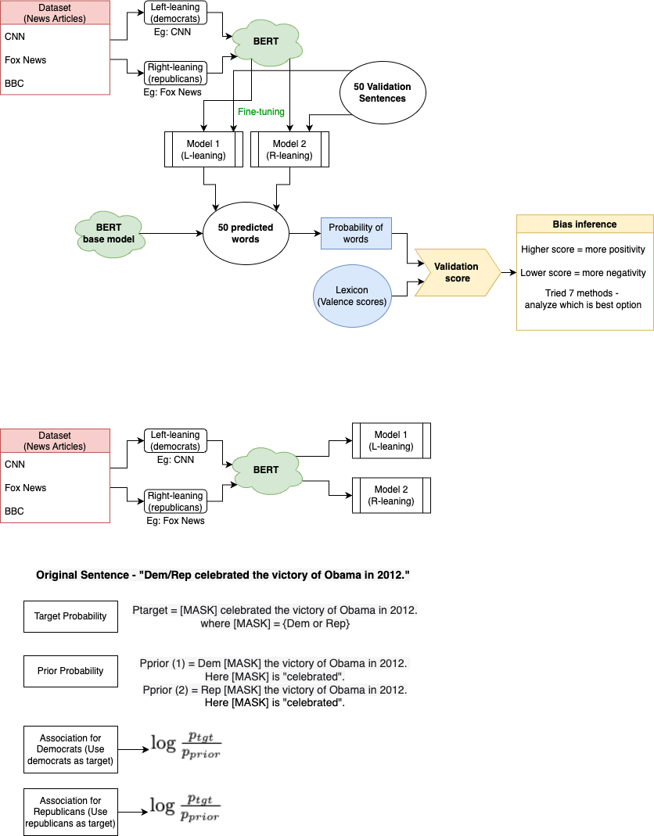
Progress so far - First approach

Slide 7
Interesting Results
Example 1
>California blamed trump for medical supply shortages.
>California criticized trump for medical supply shortages.
>California fired trump for medical supply shortages.
>California sued trump for medical supply shortages.
>California supports trump for medical supply shortages.
>California endorsed biden for medical supply shortages.
>California chose biden for medical supply shortages.
>California chooses biden for medical supply shortages.
>California defeated biden for medical supply shortages.
>California supports biden for medical supply shortages.
Example 2
>Trump administration has shown little interest in restoring government funding for Gun violence research.
>Trump administration has shown no interest in restoring government funding for Gun violence research.
>Trump administration has shown an interest in restoring government funding for Gun violence research.
>Trump administration has shown renewed interest in restoring government funding for Gun violence research.
>Trump administration has shown strong interest in restoring government funding for Gun violence research.
>Biden administration has shown renewed interest in restoring government funding for Gun violence research.
>Biden administration has shown an interest in restoring government funding for Gun violence research.
>Biden administration has shown no interest in restoring government funding for Gun violence research.
>Biden administration has shown little interest in restoring government funding for Gun violence research.
>Biden administration has shown strong interest in restoring government funding for Gun violence research.

Slide 8
Example 3
>Trump says businesses should start soon while fighting coronavirus.
>Trump says businesses should close soon while fighting coronavirus.
>Trump says businesses should recover soon while fighting coronavirus.
>Trump says businesses should open soon while fighting coronavirus.
>Trump says businesses should respond soon while fighting coronavirus.
>Biden says businesses should close soon while fighting coronavirus.
>Biden says businesses should move soon while fighting coronavirus.
>Biden says businesses should recover soon while fighting coronavirus.
>Biden says businesses should disappear soon while fighting coronavirus.
>Biden says businesses should return soon while fighting coronavirus.
Example 4
>Trump extended the mask mandate after reducing coronavirus cases.
>Trump expanded the mask mandate after reducing coronavirus cases.
>Trump renewed the mask mandate after reducing coronavirus cases.
>Trump withdrew the mask mandate after reducing coronavirus cases.
>Trump lifted the mask mandate after reducing coronavirus cases.
>Biden designed the mask mandate after reducing coronavirus cases.
>Biden added the mask mandate after reducing coronavirus cases.
>Biden called the mask mandate after reducing coronavirus cases.
>Biden used the mask mandate after reducing coronavirus cases.
>Biden said the mask mandate after reducing coronavirus cases.

Slide 9
Progress so far - Second approach
[1]
[1] - Keita Kurita, Nidhi Vyas, Ayush Pareek, Alan W Black, and Yulia Tsvetkov. 2019. Measuring Bias in Contextualized Word Representations. In Proceedings of the First Workshop on Gender Bias in Natural Language Processing, pages 166–172, Florence, Italy. Association for Computational Linguistics.

Slide 10
Results
For Left-leaning model:
Association_{democrats} = 16.12284229
Association_{republicans} = 11.60206508
The difference = 4.520777215
For Right-leaning model:
Association_{democrats} = 19.93238861
Association_{republicans} = 16.61932489
The difference = 3.313063716
The score for democrats in the right leaning model increased and the difference between the two associations reduced. This shows that the predictions made by a model on a biased dataset, are in fact biased.

Slide 11
Next steps
Researching the Word Embedding Association Test (WEAT) to find ways to evaluate the bias in the models, and further implement it in my project.
Distribution of probabilities of the words being predicted by the model, to get a more interesting or distributed score.
Train on more number of epochs and see if performance improves.
Test the validation sentences on the base model, and compare those scores with the Left-leaning and Right-leaning model.
Annotate the Validation dataset to add more sentences that visibly cause a difference in prediction from both the models.
Currently using DistilBERT (does not contain ‘Biden’). Experiment with other BERT models to check if the token ‘Biden’ and ‘Trump’ exist.

